Slide 1

SAFE AND SMART MEDICAL DATA EXCHANGE
SARANATHAN COLLEGE OF ENGINEERING (An Autonomous Institution)
Venkateswara Nagar, Panjappur, Tiruchirappalli - 620 012, Tamil Nadu.
Department of Computer Science and Engineering CS3811 – Project Work
Team Members
Purusoth K R (813821104074)
Riyaz Khan K I (813821104079)
Sivakarthikeyan D (813821104096)
Surya Prakash G (813821104107)
Guide
Ms.G. Roshini, M.TECH

Slide 2
ABSTRACT
The object detection task in the medical field is challenging in terms of classification and regression.
Due to its crucial applications, an increasing number of researchers are transferring the object detection techniques to the medical field.
In existing approaches, do not consider the low resolution of medical images, the high amount of noise, and the small size of the objects to be detected.
Here proposes algorithm named as Sequential CNN , where a self-supervised learning approach is used to perform features extraction and disease classification.
The classified disease data hide in medical image using LSB coding.
Finally implement fragmentation and cryptography techniques using ECC algorithm to secure the medical images.

Slide 3
BASE PAPER
TITLE: A Secure Medical Data Sharing Framework for Fighting Pandemics Like COVID-19 Using Public Blockchain
AUTHOR: SEVAL CAPRAZ, (Member, IEEE), AND ADNAN OZSOY
PUBLISHED YEAR: 4 July 2024
DESCRIPTION:
This project is about sharing COVID-19 medical data safely and quickly. It uses a public blockchain called Ethereum and a storage system called IPFS. Smart contracts are used to give or remove access without needing doctors’ private keys. The goal is to make data sharing fast, safe, scalable, and private during pandemics.
WEBSITE: https://doi.org/10.1109/ACCESS.2024.3423714

Slide 4
OBJECTIVE
The primary goal of this system is to ensure secure and efficient transmission of medical images while maintaining data integrity and confidentiality. Key objectives include:
Accurate Disease Classification: Utilizing Sequential CNN for feature extraction and medical image analysis.
Data Security & Privacy: Embedding classified disease information using LSB-based steganography and encrypting data via ECC encryption.
Reliable Medical Data Access: Implementing multi-secret sharing to ensure controlled retrieval by authorized healthcare providers.
Scalability & Integration: Designing the system to function within cloud-based healthcare frameworks, enabling secure remote diagnosis and data exchange.

Slide 5
INTRODUCTION
Medical imaging like Magnetic Resonance Imaging (MRI), Computed Tomography (CT), X-rays, and ultrasound has essential role in diagnosing a wide range of diseases.
Rapid improvements have been made on the internet for sharing and transferring massive amounts of information.
These medical data should be transmitted in a secure communication medium to protect patients’ sensitive information.
Confidentiality and integrity became a significant challenge in medical image transmission. So, more attention is needed to secure the medical images transferred over a public network.

Slide 6
LITERATURE SURVEY
YEAR | AUTHOR NAME | TITLE | TECHNIQUES | MERITS | DEMERITS
2021 | Adnan Qayyum | Secure and Robust Machine Learning for Healthcare: A Survey | Long Short Term Memory (LSTM) | Easily detects the objects . | Drop - outs algorithm to mitigate this problem is difficult
2021 | Fawad Masood | A Lightweight Chaos‑Based Medical Image Encryption Scheme Using Random Shuffling and XOR Operations | Cryptography | It can protect data and communication from unauthorised disclosure and access. | High Cost Implementation
2021 | Mohammad Kamrul Hasan. | Lightweight Encryption Technique to Enhance Medical Image Security on Internet of Medical Things Applications | Image Encryption | Relatively Quick | Increased Damage if Compromised

Slide 7
LITERATURE SURVEY
YEAR | AUTHOR NAME | TITLE | TECHNIQUES | MERITS | DEMERITS
2019 | Puvvadi Aparna | Biometric-based efficient medical image watermarking in E-healthcare application | Elliptical curve cryptography (ECC)-based encryption | It requires less computational power | More complicated and difficult to apply
2021 | Sara T. Kamal. | A New Image Encryption Algorithm for Grey and Color Medical Images | Image Encryption | It provides more secure and confidentiality. | Lost the password unable to decrypt the data

Slide 8
PROBLEM DEFINITION
Medical imaging like Magnetic Resonance Imaging (MRI), Computed Tomography (CT), X-rays, and ultrasound has essential role in diagnosing a wide range of diseases.
Rapid improvements have been made on the internet for sharing and transferring massive amounts of information.
These medical data should be transmitted in a secure communication medium to protect patients’ sensitive information.
During transmission of medical images, the image is captured and tampered by the attacker will lead to a false diagnosis issue
Confidentiality and integrity became a significant challenge in medical image transmission. So, more attention is needed to secure the medical images transferred over a public network.

Slide 9
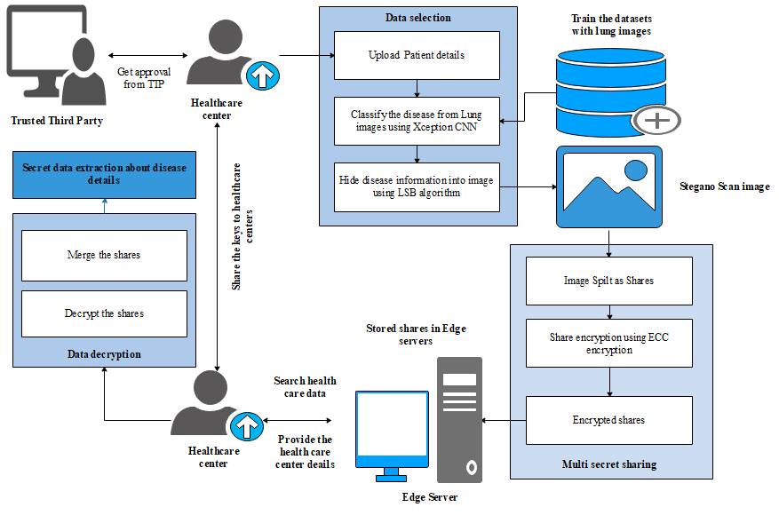
PROPOSED SYSTEM
ARCHITECTURE
.

Slide 10
EXPLANATION OF PROPOSED WORK
Privacy, integrity, and robustness for the extracted information are important security issues because deep learning enables object detection in images.
Object detection techniques in the medical field have been widely used in many practical medical diagnostic applications.
Medical image disease classification using convolutional neural networks (CNN) is a rapidly growing field of research that aims to develop accurate and efficient systems for automated disease diagnosis and treatment.
CNNs are deep learning models that have been shown to achieve state-of-the-art results in various computer vision tasks, including medical image analysis.

Slide 11
EXPLANATION OF PROPOSED WORK
The extracted medical information is hiding within medical image using LSB algorithm.
Then the stegno image was applied for multi secret sharing approach.
Image sharing with medical data hiding using multi-secret sharing and encryption is a technique used to securely transmit and store medical images by splitting the image into multiple shares, each encrypted with a ECC based different secret key.
This technique not only enhances the security and privacy of medical images, but also allows for efficient and reliable sharing of medical data between healthcare professionals.

Slide 12
MODULE LIST
FRAMEWORK CONSTRUCTION
FEATURES EXTRACTION
DISEASE PREDICTION
DATA HIDING WITH FRAGEMENATION
DATA ENCRYPTION
ACCESS THE MEDICAL IMAGE DATA

Slide 13
Framework Construction: A cloud framework is developed to create a structured and reliable environment. It includes:
Health Care Centers: Upload patient data.
Edge Server: Manages and stores all patient details.
Trusted Third Party: Approves the operations of health care centers and edge servers.
Features Extraction: Focus on extracting critical information like color, shape, and texture from lung images. This step ensures that the high-dimensional image data is reduced while retaining meaningful details to differentiate between different medical conditions.

Slide 14
Disease Prediction:
Use Convolutional Neural Networks (CNNs) to analyze lung images. The CNN learns patterns indicative of specific lung diseases using a large labeled dataset, enabling it to predict diseases with high accuracy for new and unseen medical images.
Data Hiding with Fragmentation:
The detected disease details are embedded into medical scan images using Least Significant Bit (LSB) hiding. This technique ensures the changes are imperceptible to the human eye. The modified images (Stegno images) are then split into multiple parts for enhanced security.

Slide 15
Data Encryption:
The split image fragments are encrypted using Elliptic Curve
Cryptography. This ensures the medical image data remains secure during
transmission or storage. Only the private key associated with the public key used
in encryption can decrypt these fragments.
Access Control: When health care centers request the medical data stored on
edge servers, the encrypted fragments are sent to the respective center.
Using their ECC private key,
they can:
Decrypt the fragments.
Merge them back into the complete image.
Extract hidden disease information.

Slide 16
SOFTWARE REQUIREMENTS
Operating System : Windows OS
Front End : Python
IDE : Pycharm
Back End : MySQL
Application : Web Application

Slide 17
FEATURES
Sequential CNN for Disease Detection: Uses deep learning for precise classification of medical conditions.
LSB-based Steganography for Data Hiding: Conceals disease-related data within medical images for added security.
Elliptic Curve Cryptography (ECC) for Encryption: Ensures secure transmission by fragmenting and encrypting image data.
Multi-Secret Sharing for Secure Access: Divides encrypted medical images into multiple shares, allowing authorized retrieval only.
Cloud-Based Healthcare Framework: Provides structured data storage and management via edge servers and trusted third parties.

Slide 18
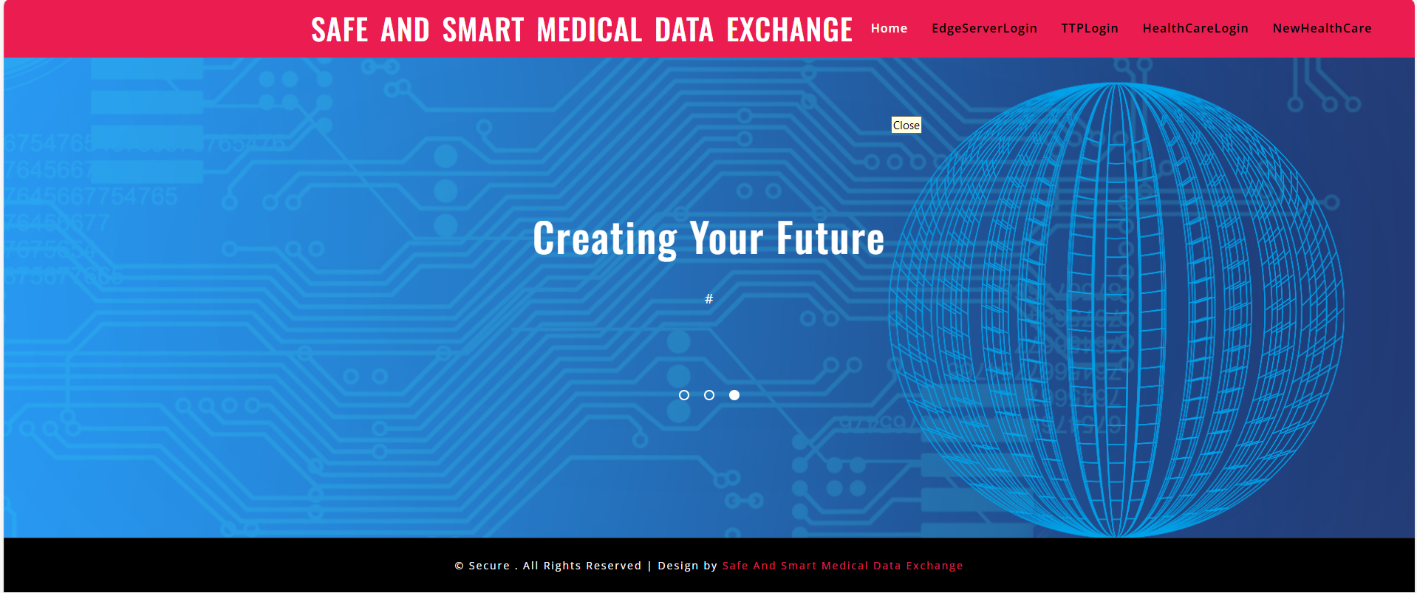
EXCEPTED OUTCOMES

Slide 19
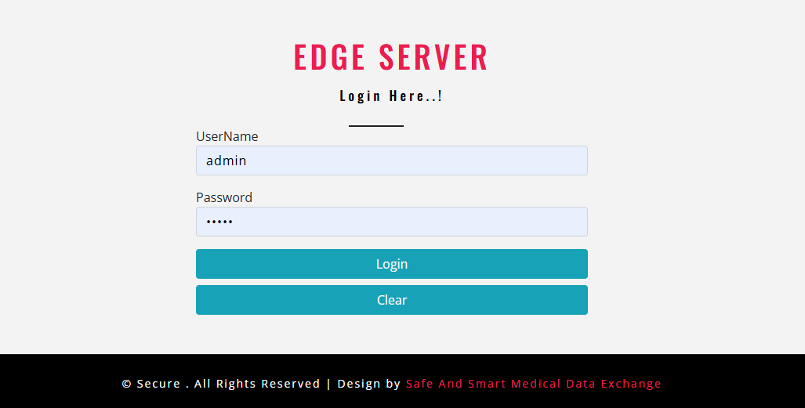
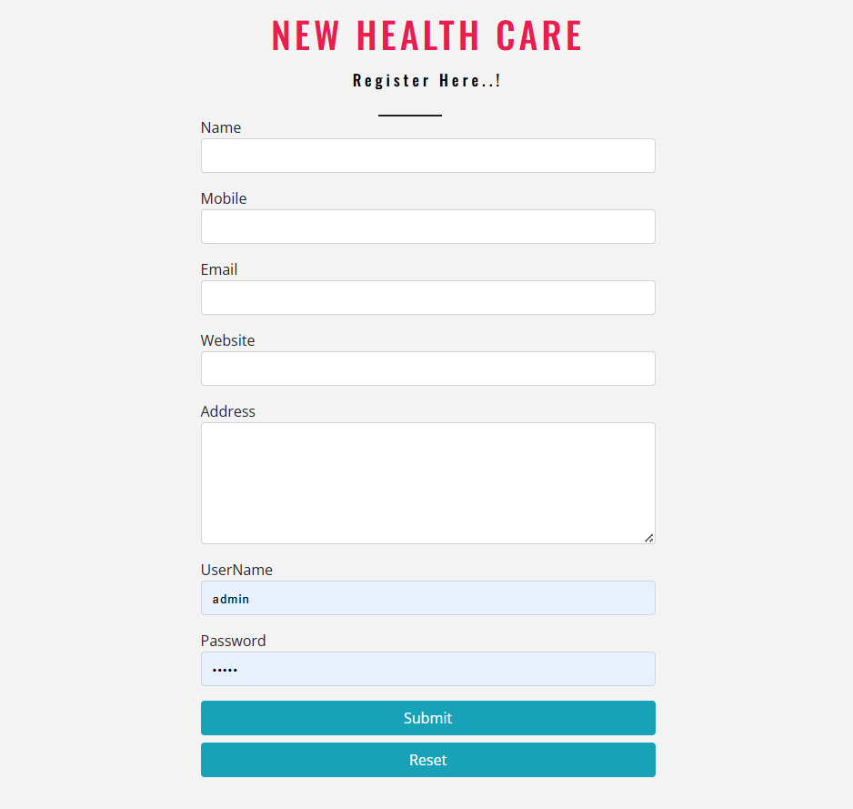
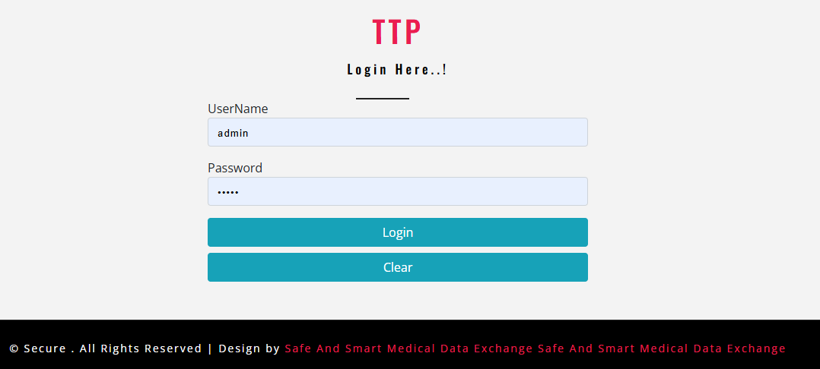

Slide 20
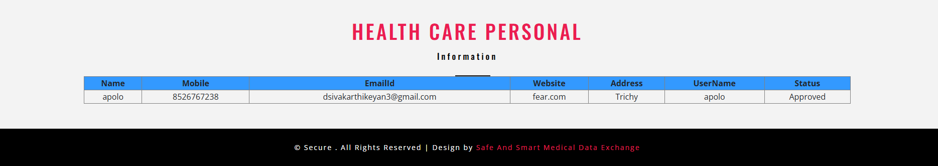
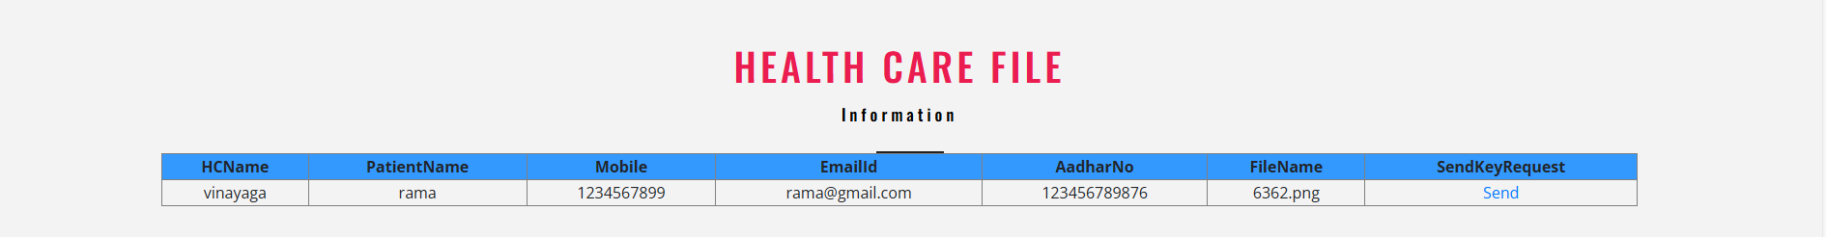


Slide 21
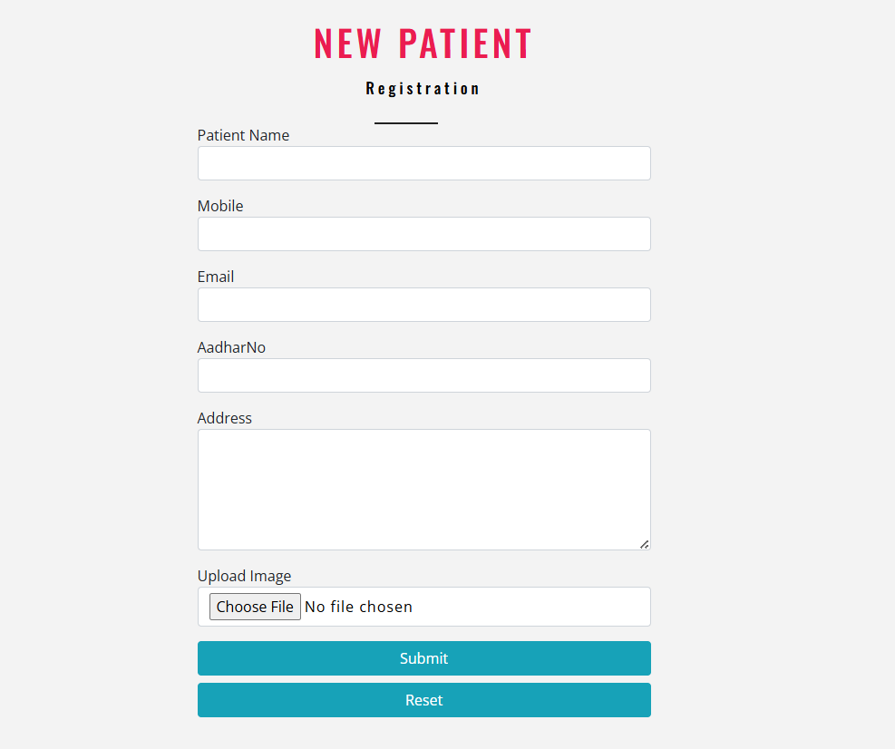
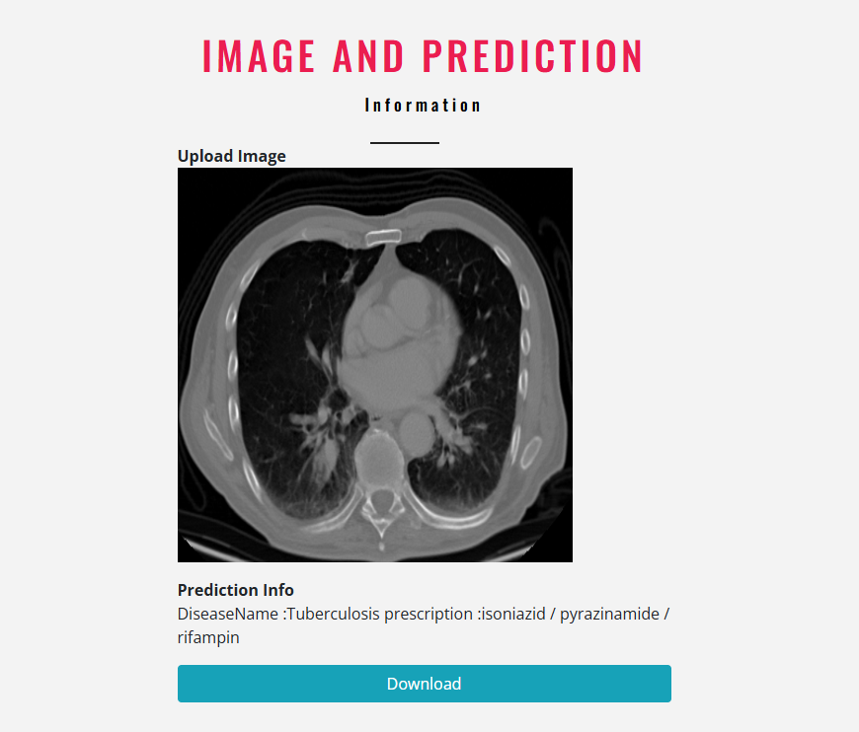

Slide 22
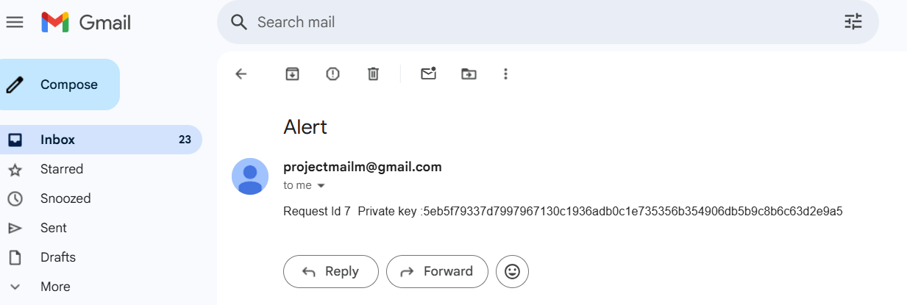

Slide 23
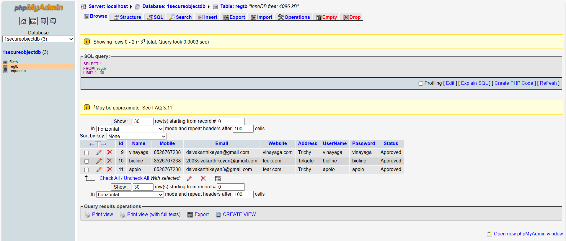

Slide 24
EXPECTED OUTCOMES
Enhanced Security & Privacy: Secure transmission ensures protection against tampering and unauthorized access.
Accurate Disease Detection: CNN-based classification improves diagnostic reliability for medical imaging.
Efficient Data Retrieval & Access Control: Authorized healthcare providers can securely retrieve encrypted data.
Scalable System Integration: Designed for cloud environments, enabling expansion across multiple medical institutions.
24

Slide 25
RESULT
The system demonstrates effective classification of diseases in medical images and secure transmission through ECC-based encryption and multi-secret sharing. Preliminary evaluations suggest high accuracy in disease detection and robust security measures preventing unauthorized tampering.
Disease Classification: Sequential CNN achieves high-precision diagnosis with optimized feature extraction and robust performance metrics.
Data Hiding & Security: Medical information is embedded via LSB encoding and encrypted using ECC-256, ensuring confidentiality.
Multi-Secret Sharing: Image fragments are distributed securely, requiring a threshold for authorized reconstruction.
Performance Validation: System demonstrates low latency, minimal storage overhead, and resilience against cryptographic attacks.

Slide 26
CONCLUSION
The Safe and Smart Medical Data Exchange system presents a scalable and secure approach to handling medical images, integrating AI-driven diagnostics with encryption techniques.
It ensures privacy, integrity, and accessibility, making it a promising solution for modern healthcare environments.

Slide 27
REFERENCES
[1] Qayyum, Adnan, Junaid Qadir, Muhammad Bilal, and Ala Al-Fuqaha. "Secure and robust machine learning for healthcare: A survey." IEEE Reviews in Biomedical Engineering 14 (2020): 156-180.
[2] Masood, Fawad, Maha Driss, Wadii Boulila, Jawad Ahmad, Sadaqat Ur Rehman, Sana Ullah Jan, Abdullah Qayyum, and William J. Buchanan. "A lightweight chaos-based medical image encryption scheme using random shuffling and XOR operations." Wireless Personal Communications (2021): 1-28.
[3] Hasan, Mohammad Kamrul, Shayla Islam, Rossilawati Sulaiman, Sheroz Khan, Aisha-Hassan Abdalla Hashim, Shabana Habib, Mohammad Islam et al. "Lightweight encryption technique to enhance medical image security on internet of medical things applications." IEEE Access 9 (2021): 47731-47742.
[4] Aparna, Puvvadi, and Polurie Venkata Vijay Kishore. "Biometric‐based efficient medical image watermarking in E‐healthcare application." IET Image Processing 13, no. 3 (2019): 421-428.
[5] Kamal, Sara T., Khalid M. Hosny, Taha M. Elgindy, Mohamed M. Darwish, and Mostafa M. Fouda. "A new image encryption algorithm for grey and color medical images." IEEE Access 9 (2021): 37855-37865.

